Slide 1

Decentralized KYC System Using Blockchain
Team No : 37
Bhajan Kumar barman (181IT211)
Debabrat Parida (181IT114)
Suraj Suthar (181IT248)

Slide 2
Introduction
KYC(Know Your Customer) is a process by which banks obtain information about customer to validate their identity and their appropriateness to access risk in having banking relationship.
The KYC process is complex,less secure, time consuming and involves a high cost for completing for a single customer.With the advent of Blockchain technology, its properties such as immutability, security, decentralization make them a good solution to such problems.
Hence Sharing KYC information on Blockchain would enable financial institutions to deliver better compliance outcomes, increase efficiency, and improve customer experience.

Slide 3
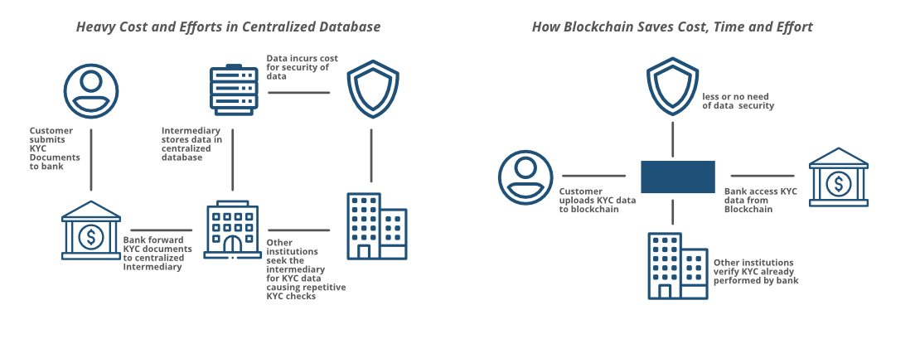

Slide 4
Literature Survey
Paper | Author | About the paper
Transforming the Know Your Customer (KYC) Process using Blockchain | Piyush Yadav; Raj Chandak | Solution based on Distributed Ledger Technology , which will reduce the traditional KYC verification process cost for Institutions. Used ethereum API for building the blockchain using solidity language to create a smart contract.And integrated with a android application.

Slide 5
Cont.
Paper | Author | About the paper
Secure and Transparent KYC for Banking System Using IPFS and Blockchain Technology | Abdullah Al Mamun; Sheikh Riad Hasan; Md Salahuddin Bhuiyan | Proposed system allows a customer to open an account at one Bank, complete the KYC process there, and generate a hash value using the IPFS network and share it using the blockchain technique. Upon receiving the private key, any Bank/financial organization can retrieve, store customer data (i.e., KYC) securely using IPFS network if the customer wishes to open another account in that Bank/financial organization.

Slide 6
Methodology
Step I: Designed a smart contract and implemented it in the solidity language.
Step II: Designed User Interface for the application and implemented using React framework.
Step III : Designed the backend to handle all the requests from the frontend and implemented using Nodejs.
Step IV : The Decentralized KYC application runs on an ethereum network.

Slide 7
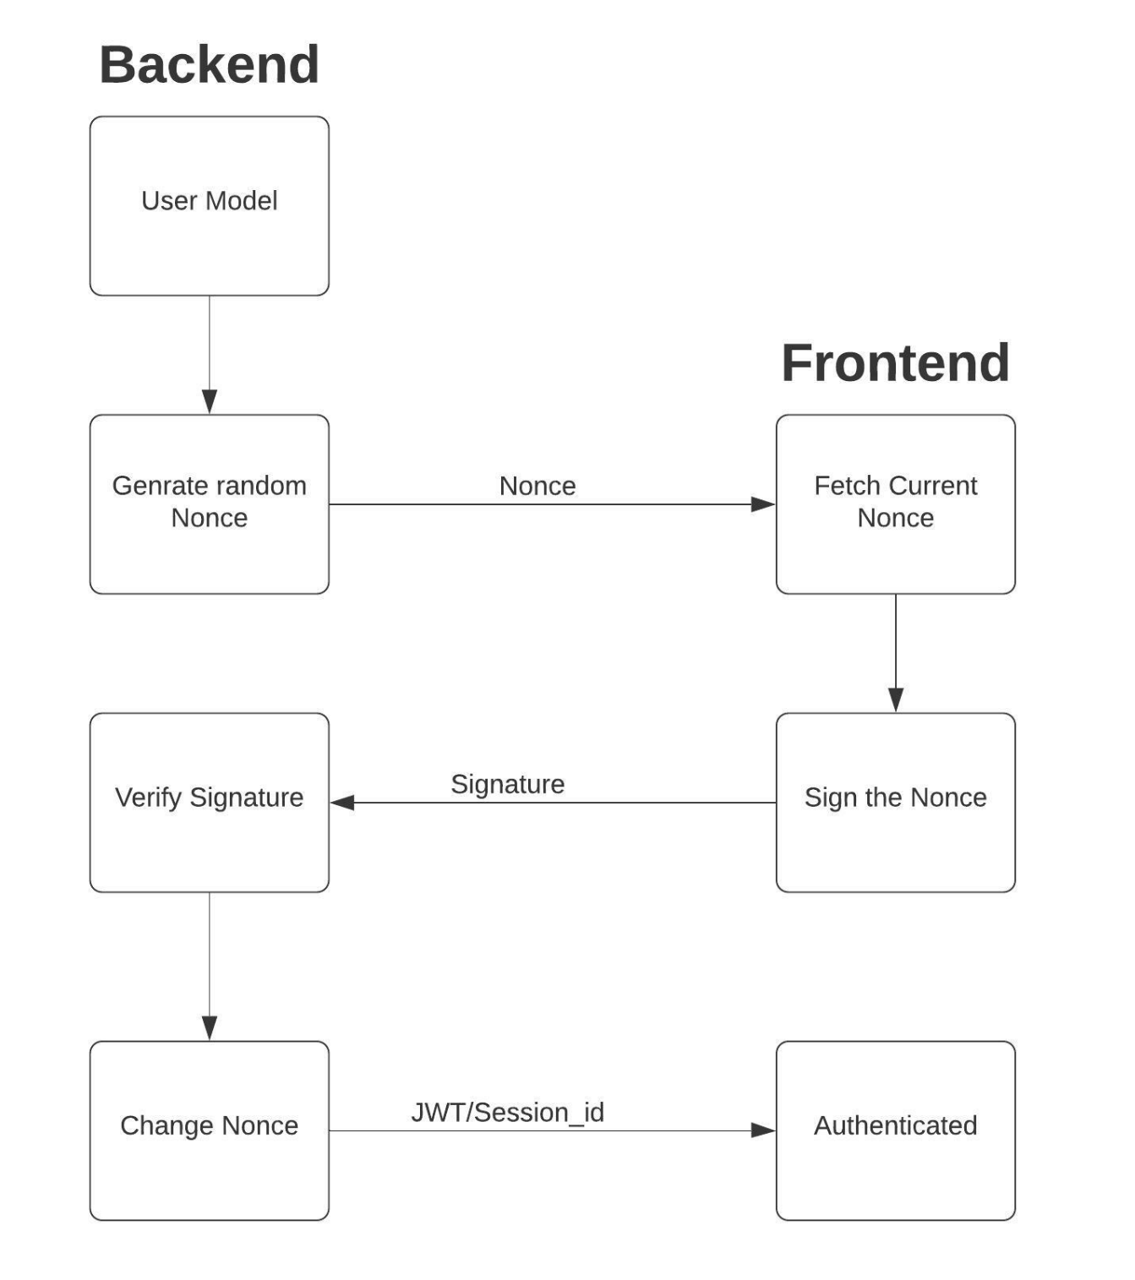
Authentication Flow
Generating a one-time nonce.
User interacts with Metamask to sign this one time nonce.
Signature generated using metamask
Signature is verified and Authentication is done

Slide 8
Results
KYC DApp Features:
One click authentication with Metamask.
Role based authorization.
Admin can verify banks and add them to the network.
Banks can upvote other banks. Based on the votes, the bank rating is being calculated.
Bank can add the customer KYC request and can process it further for verification by other banks if and only if the other rating of the bank is more than 50%.
Banks can verify the data of the customer and up-vote the verification request raised by other banks.
Customer's KYC request is considered valid if the customer request's rating is more than 50%.

Slide 9
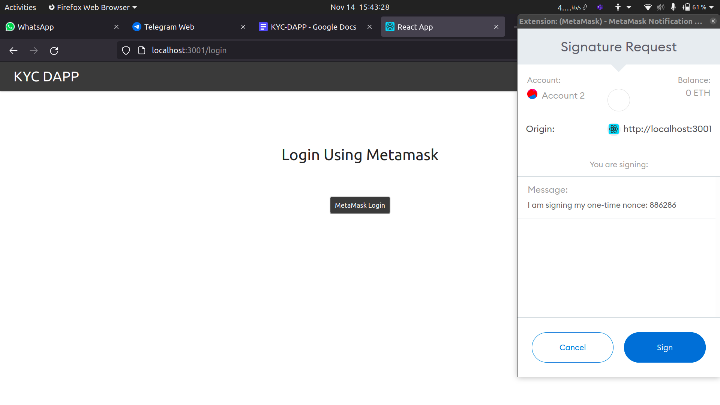
Cont.

Slide 10
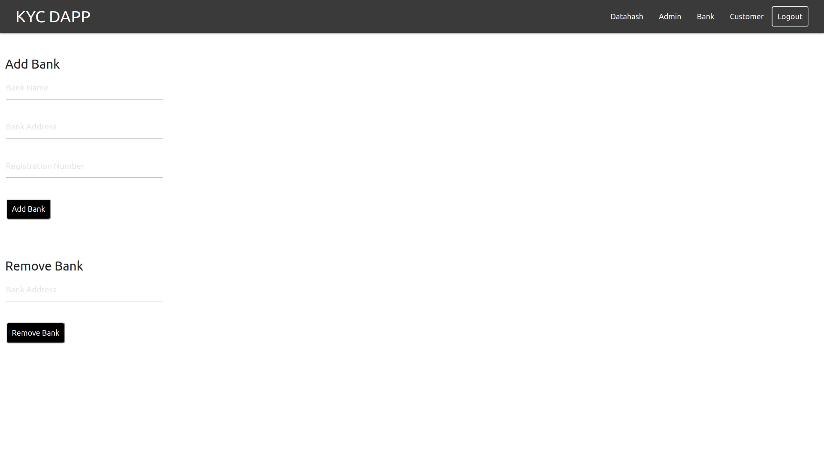
Cont.

Slide 11
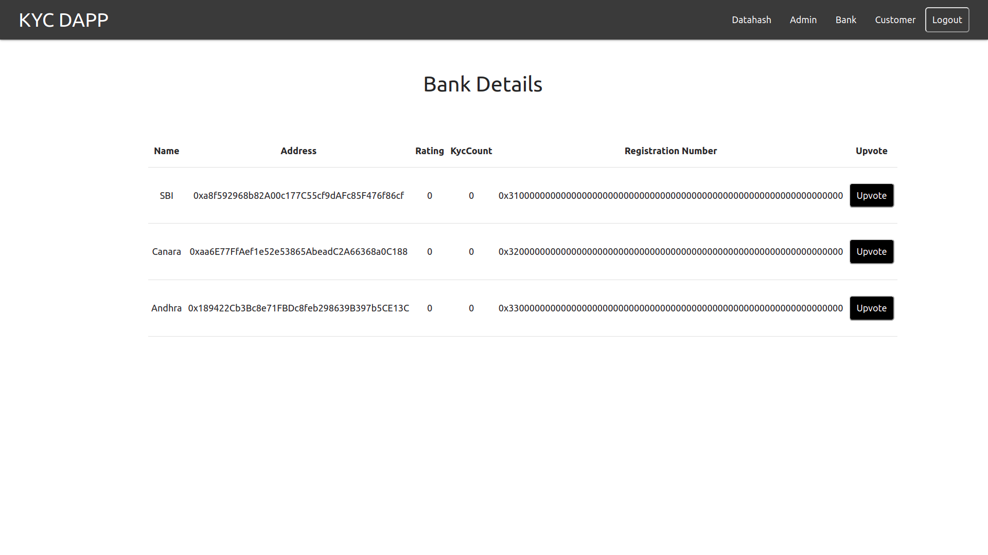
Cont.

Slide 12
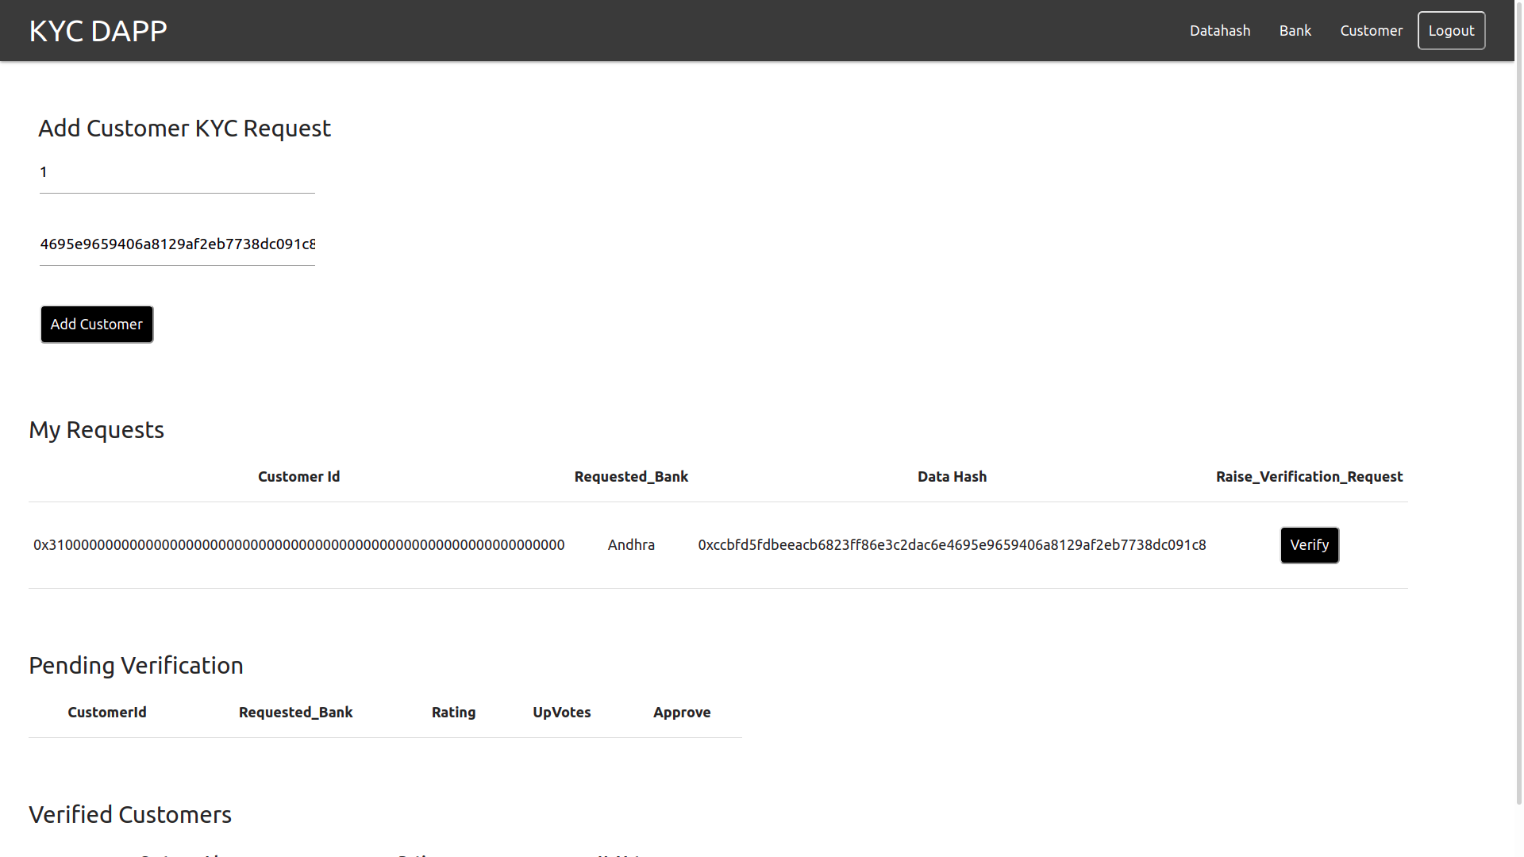
Cont.

Slide 13
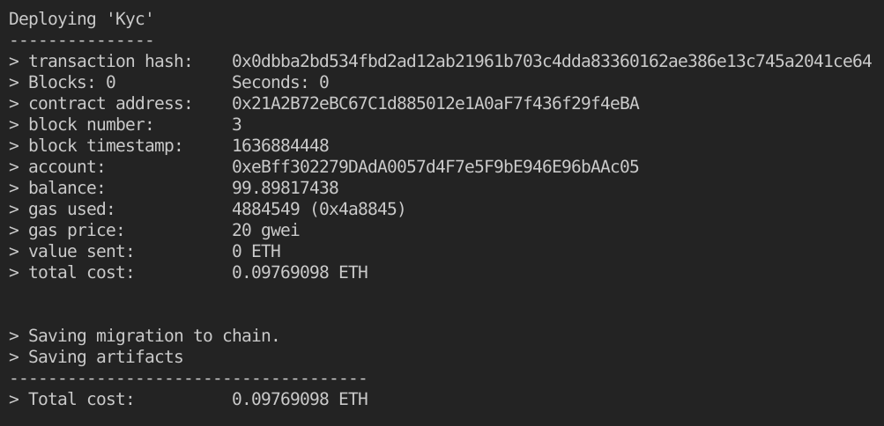
Cont.

Slide 14
Conclusion
The proposed solution addresses the problem of redundant registration in the KYC process encountered in the existing situation.
The KYC verification is done in a decentralized manner.
The application will be useful for both banks and customers.
A lot of time and paperwork can be saved using the Decentralized KYC application.
User Details are permanently stored in a blockchain and can’t be tampered by any user.

Slide 15
References
[1] José Parra Moyano and Omri Ross, "KYC Optimization using Distributed Ledger technology", Springer -Business & Information
systems Engineering, , pp-411-423, vol.59,2018.
[2] G. Zyskind, O. Nathan and A. Pentland, "Decentralizing Privacy: Using Blockchain to Protect Personal Data", IEEE Security and Privacy Workshops, San Jose, CA, 2015.
[3] Mauro Isaja and John Soldatos, Distributed ledger technology for decentralization of manufacturing processes,IEEE Conference on Industrial Cyber-Physical Systems (ICPS) 2018 at, St. Petersburg, Russia, pp 696- 701,2018..
[4] Rui Yuan, Yu-Bin Xia, Hai-Bo Chen, Bin-Yu Zang, Jan Xie and ShadowEth: Private Smart Contract on Public Blockchain, Springer, Journal of Computer Science and Technology, Issue 3, pp 542–556. vol 33,2018.
[5] M. Harrop. “Know your Customer (KYC) Independent Survey.” Thomson Reuters.
[6] “How Do Ethereum Smart Contracts Work?” CoinDesk.https://www.coindesk.com/information/ethereum-smart-contracts-work/
[7] “Learn About Ethereum.” Ethereum.
https://ethereum.org/learn/#ethereum-basics

Slide 16
THANK YOU

